Slide 1
DATA SPLITTER

Slide 2
A DATA SPLITTER is program which is use to break a file in to two or more parts and merges those parts in to original file.
Maximum quality of the data is retained even if the data is split and merge

Slide 3
NEED OF SPLITTER
Sometime it is necessary to transfer files from one system to another.
In such a case there is possibility that size of file to be transfer is to large to fit in storage device.
At this point splitter comes in picture. With the help of splitter, large file is converted or is split into two or more parts and then transfer from one system to another using storage device.
In this file splitter project it is possible to split any type of file. Therefore name is ALL IN ONE FILE SPLITTER.
It can split and merge files of type video such as .avi, .mpeg also audio such as .mp3,.wav and text files such as .txt, .doc etc.

Slide 4
TOOLS & TECHNOLOGY
File splitter is been developed in JAVA language.
Why java?
Simple to use
High Performance
Multithreading
Dynamic Programming

Slide 5
WHAT A SPLITTER SHOULD DO?
Splitter should Split the file in two or more parts
Its should Merge the file accurately without any data loss

Slide 6
SPLITTER LOGIC

Slide 7
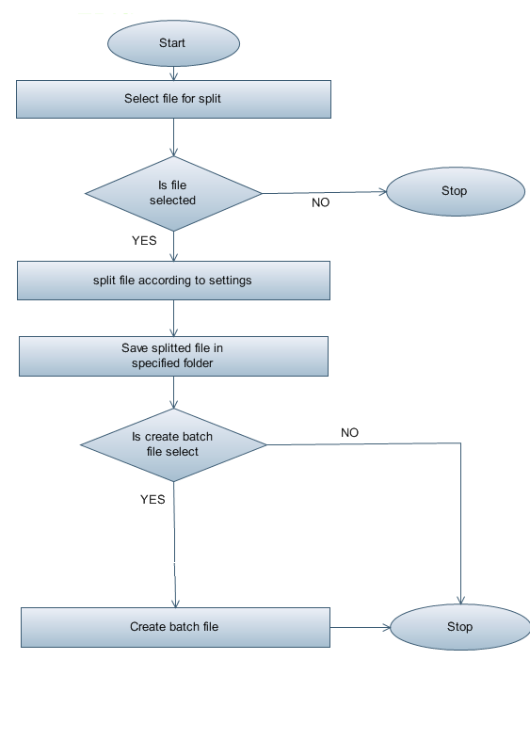
SPLIT

Slide 8
SPLITTING

Slide 9
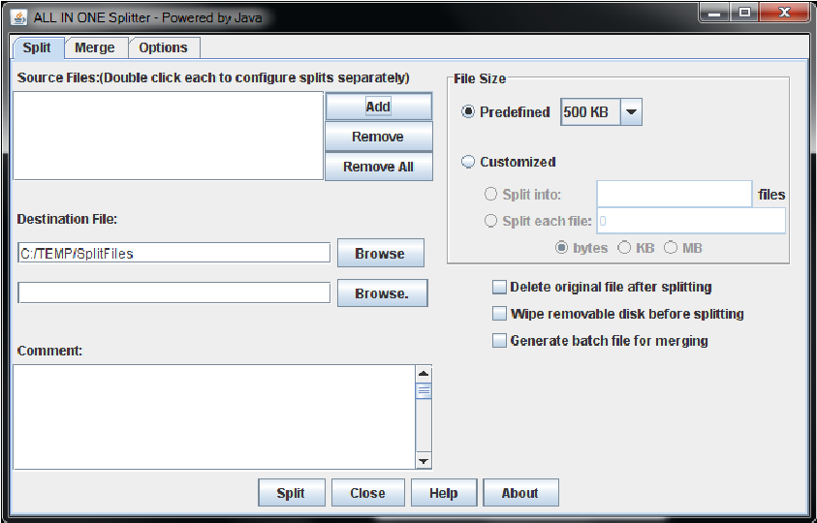

Slide 10
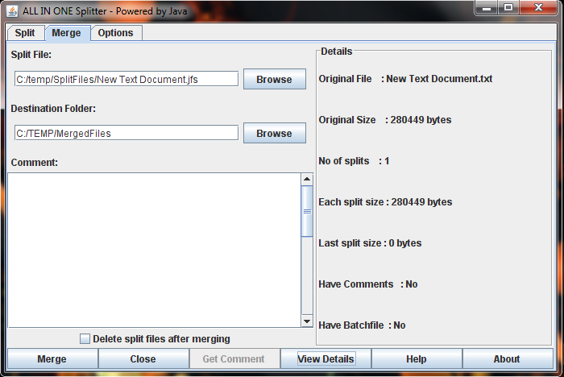

Slide 11
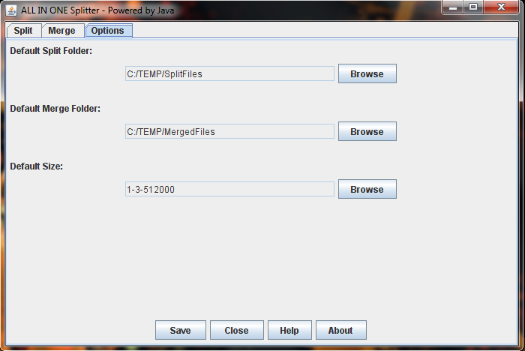

Slide 13
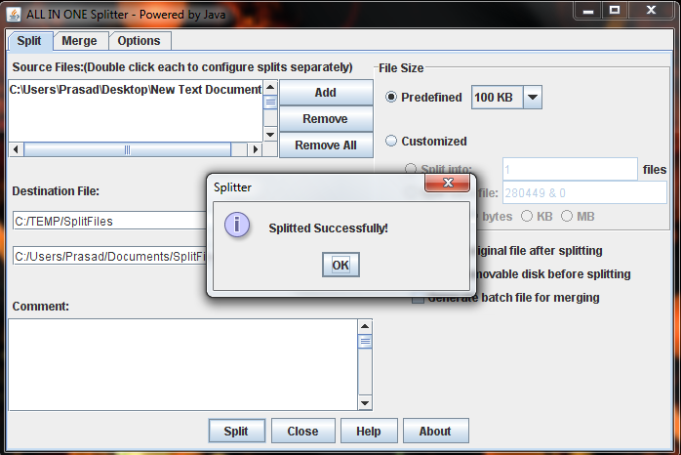

Slide 14
MERGING

Slide 15
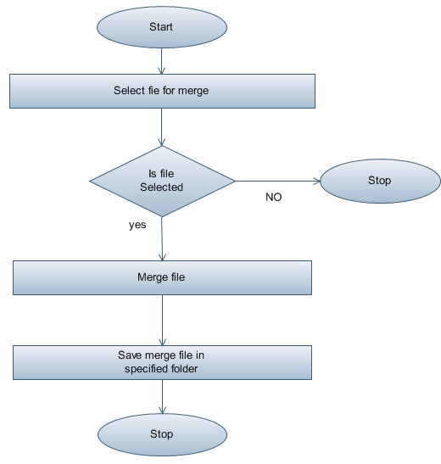
MERGE

Slide 18
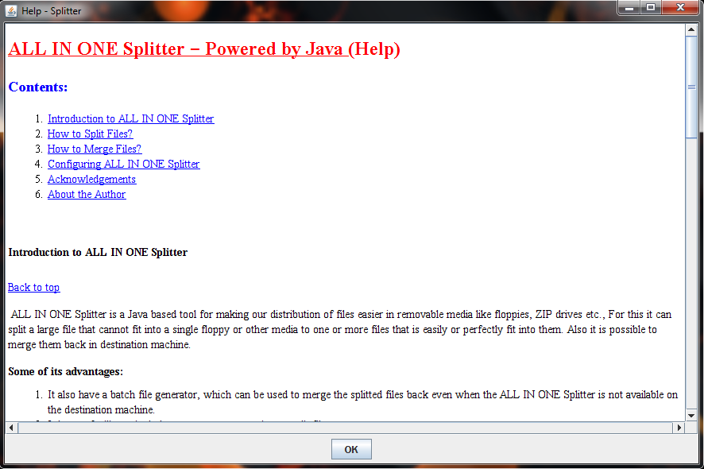

Slide 19
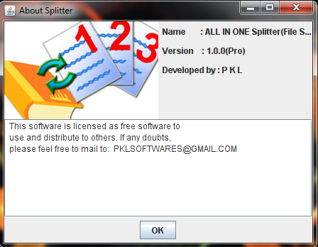

Slide 20
ADVANTAGE
Any type of file can be splitted and can merge.
Batch file can be generated for merging.
Customize size for splitted parts.

